Slide 1
Soap WS With Spring Boot & AOP Implementation - Manu Lahariya

Slide 2
Topic
Micro services
WSDL structure, target namespace (tns)
Soap Protocol
Soap Message (Structure)
Soap Fault
Tools (wsimport / wsgen)
Soap-service implementation via Spring Boot
Aop Components
Aop Implementation in Spring Boot Soap ws

Slide 3
Micro Services
What is really-means?
What are benefits?
Micro Services Architecture on spring cloud ?

Slide 4
Micro Services
What is really-means?
Create your application as a suite of services instead of one tightly coupled monolith of code, and it's easier to change and maintain particularly an Internet application that's supposed to be running 24/7.
Just refactor and redeploy a couple of services rather than rejiggering and re-releasing the monolith.

Slide 5
Micro Services
Micro-services allow large systems to be built up from a number of collaborating components.
It does at the process level ie. loosely coupled processes instead of loosely coupled components.
A micro-service is a stand-alone process that handles a well-defined requirement.

Slide 6
Micro Services
As micro-services are quite a new term it is not easy to define and there's no standard definition out there that everyone is happy with. There’s is many discussions as to how “micro” a service should be, if data should be part of each service, and if “micro” is actually a good word, as with decoupled services there’s a natural limit to the lower barrier of a service in terms of size.

Slide 7
Micro Services
What are benefits?
When services are shared, redundant work can be eliminated.
No one has developed a hard and fast size limit for the "micro" in micro-services, the basic concept is that each service performs a single function.
Spring Boot is a popular framework for building Java micro-services. The primary design goals include:
A very fast startup time
Low memory footprint
Small pack size
High throughput and low latency

Slide 8
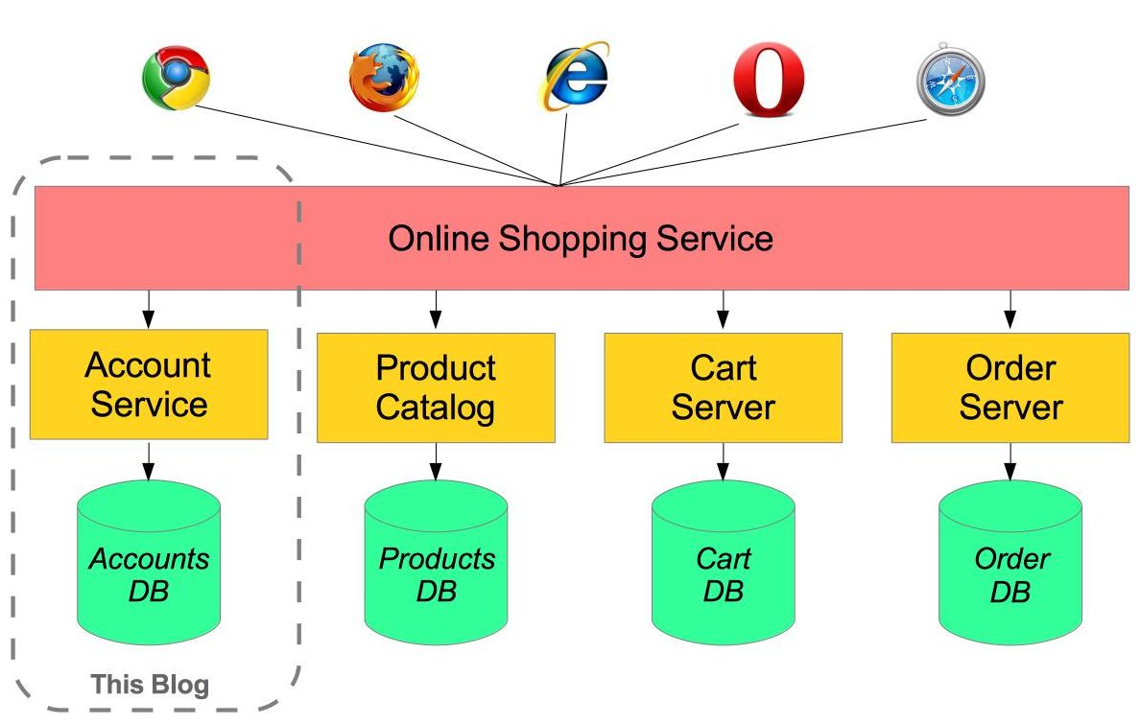
Micro Services
What is architecture on cloud?

Slide 9
Web Services
As my brief knowledge with the web services, it is designed to support interoperable machine-to-machine interaction over a network with different programming language such as Java and C++.
A web service is any piece of software that makes itself available over the internet and uses a standardized XML messaging system.
Web services are self-contained, modular, distributed, dynamic applications that can be described, published, located, or invoked over the network to create products, processes, and supply chains. These applications can be local, distributed, or web-based. Web services are built on top of open standards such as TCP/IP, HTTP, Java, HTML, and XML.
Web services are XML-based information exchange systems that use the Internet for direct application-to-application interaction. These systems can include programs, objects, messages, or documents.
In short, Web services are open standard (XML, SOAP, HTTP etc.) based Web applications that interact with other web applications for the purpose of exchanging data.

Slide 10
WSDL
WSDL stands for Web Services Description Language. It is the standard format for describing a web service. WSDL was developed jointly by Microsoft and IBM.
WSDL is an XML-based protocol for information exchange in decentralized and distributed environments.
WSDL definitions describe how to access a web service and what operations it will perform.

Slide 11
WSDL Components
The three major elements of WSDL that can be defined separately are:
Types
Operations
Binding
A WSDL document contains the following elements:
Definition : It is the root element of all WSDL documents. It defines the name of the web service, declares multiple namespaces used throughout the remainder of the document, and contains all the service elements described here.

Slide 12
WSDL Components
The <definitions> element must be the root element of all WSDL documents. It defines the name of the web service. name is optional.
xmlns is the default namespace of the WSDL document, and it is set to http://schemas.xmlsoap.org/wsdl/.
xmlns:xsd and xmlns:soap are standard namespace definitions that are used for specifying SOAP-specific information.
<wsdl:definitions name="MathsDbServiceImplService"
targetNamespace="http://dm.xml.soap.sample.com/" xmlns:wsdl="http://schemas.xmlsoap.org/wsdl/"
xmlns:xsd="http://www.w3.org/2001/XMLSchema" xmlns:tns="http://dm.xml.soap.sample.com/"
xmlns:soap="http://schemas.xmlsoap.org/wsdl/soap/">
specifies a targetNamespace attribute. The targetNamespace is a convention of XML Schema that enables the WSDL document to refer to itself.

Slide 13
WSDL Components
The target namespace in the WSDL file will be the name space associated with the SOAP service itself.
Namespaces are a bit like Java packages they just allow you to define a hierarchy of objects.
Namespace is like Java namespace. Each xml element is in a namespace. Providing a targetNamespace means that all elements (and types) defined within are in that namespace. It's similar to that all Java classes are within the package.
targetNamespace is the logical namespace for information about this service. WSDL documents can import other WSDL documents, and setting targetNamespace to a unique value ensures that the namespaces do not clash.
Target namespace is a way of ensuring that your taget tag doesn't clash with anything else in your wsdl. Target is where the web service lives.
The targetNamespace in the <wsdl:definitions> element creates a namespace for all the elements that you define in the WSDL document (messages, portTypes, bindings, services, and ports). Although the attribute is optional, you should always create a namespace.

Slide 14
WSDL Components
Data types : A web service needs to define its inputs and outputs and how they are mapped into and out of the services. WSDL <types> element takes care of defining the data types that are used by the web service.
Message :The <message> element describes the data being exchanged between the web service providers and the consumers. Each Web Service has two messages: input and output. The input describes the parameters for the web service and the output describes the return data from the web service. Each message contains zero or more <part> parameters, one for each parameter of the web service function.
Each <part> parameter associates with a concrete type defined in the <types> container element.

Slide 15
WSDL Components
Port type : It is an abstract set of operations, defining the collection of operations. element combines multiple message elements to form a complete operation.
<wsdl:portType name="MathsDbService">
<wsdl:operation name="selectAllEmpAllData">
<wsdl:input name="selectAllEmpAllData" message="tns:selectAllEmpAllData">
</wsdl:input>
<wsdl:output name="selectAllEmpAllDataResponse" message="tns:selectAllEmpAllDataResponse">
</wsdl:output>
</wsdl:operation>
</wsdl:portType>

Slide 16
WSDL Components
Binding : element provides specific details on how a portType operation will actually be transmitted over the wire. The bindings provide concrete information on what protocol is being used to transfer portType operations. The bindings provide information where the service is located.

Slide 17
WSDL Components
Service : The <service> element defines the ports supported by the web service.
Web service clients can learn the following from the service element:
where to access the service, through which port to access the web service, and how the communication messages are defined.
The service element includes a documentation element to provide human-readable documentation.
<wsdl:service name="MathsDbServiceImplService">
<wsdl:port name="MathsDbServiceImplPort" binding="tns:MathsDbServiceImplServiceSoapBinding">
<soap:address location="http://localhost:8080/DmService/1.0" />
</wsdl:port>
</wsdl:service>

Slide 18
Soap
SOAP stands for Simple Object Access Protocol
SOAP is an application communication protocol SOAP is a format for sending and receiving messages
SOAP is platform independent
SOAP is based on XML
SOAP is a W3C recommendation
SOAP is a protocol specification for exchanging structured information in the implementation of Web services in computer networks. It relies on XML as its message format.

Slide 19
Soap Building Blocks
A SOAP message is an ordinary XML document containing the following elements:
An Envelope element that identifies the XML document as a SOAP message
A Header element that contains header information
A Body element that contains call and response information
A Fault element containing errors and status information

Slide 20
Soap Building Blocks
The SOAP Envelope Element: The required SOAP Envelope element is the root element of a SOAP message. This element defines the XML document as a SOAP message.
<soapenv:Envelope xmlns:dm=http://dm.xml.soap.sample.com/ xmlns:soapenv="http://schemas.xmlsoap.org/soap/envelope/">
The namespace defines the Envelope as a SOAP Envelope. If a different namespace is used, the application generates an error and discards the message.
The encodingStyle attribute is used to define the data types used in the document. This attribute may appear on any SOAP element, and applies to the element's contents and all child elements.
A SOAP message has no default encoding. soap:encodingStyle="URI“
The optional SOAP Header element contains application-specific information (like authentication, payment, etc) about the SOAP message. If the Header element is present, it must be the first child element of the Envelope element.

Slide 21
Soap Building Blocks
The SOAP Body Element : contains the actual SOAP message intended for the ultimate endpoint of the message. Immediate child elements of the SOAP Body element may be namespace-qualified.
The SOAP Fault Element: The optional SOAP Fault element is used to indicate error messages. The SOAP Fault element holds errors and status information for a SOAP message. If a Fault element is present, it must appear as a child element of the Body element. A Fault element can only appear once in a SOAP message.

Slide 22
Tools
The wsimport tool: reads a WSDL and generates all the required artifacts for web service development, deployment, and invocation. supports the top-down approach to developing JAX-WS Web services, where you are starting from a wsdl.
The wsimport tool generated JAX-WS portable artifacts include Service Endpoint Interface (SEI),
Service, Exception class mapped from wsdl:fault (if any), JAXB generated value types (mapped java classes from schema types) etc.
The wsimport tool can be launched using the command line script wsimport.sh (Unix) or wsimport.bat (windows).
Wsimport –keep wsdl location

Slide 23
Tools
The wsgen tool: The wsgen tool reads an existing web service implementation class (SIB) and generates the required JAX–WS portable artifacts for web service development and deployment.
The wsgen tool can be used for bottoms-up approach, where you are starting from a service endpoint implementation (SIB) rather than a wsdl.
From JAX-WS RI 2.1.4 onwards, you don't have to run wsgen, the runtime takes care of it by generating all required classes dynamically.
The wsgen utility generates: JAXB classes, WSDL file if -wsdl option is specified.
Example of generating a WSDL document
% wsgen -cp "." -wsdl ch01.es.ExamServerImpl
Example of generating artifacts
% wsgen -keep -cp . ch01.ts.TimeServerImpl

Slide 24
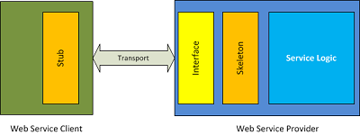
Stub & Skelton
Stub and skeleton are counterparts in a web service setup.
Skeleton belongs to service provider side and stub belongs to receiver side.
At lower level stub and skeleton communicate with each other.
From client side the business objects communicates with stub objects and stub takes the responsibility form the message and invoke the web service.
Once the invoking is done, at service provider side, skeleton is the parallel object for stub and it receives the request message and understands it and passes on the information to service side business objects.

Slide 25
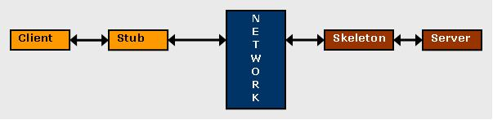
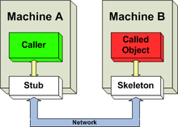
Stub & Skelton
A client SOAP Engine contains the stubs objects. The server SOAP Engine contains the skeleton objects.

Slide 26
Disadvantages of Soap web service
Slow: SOAP uses XML format that must be parsed to be read. It defines many standards that must be followed while developing the SOAP applications. So it is slow and consumes more bandwidth and resource.
WSDL dependent: SOAP uses WSDL and doesn't have any other mechanism to discover the service.

Slide 27
Aspect Oriented Programming (AOP)
Spring AOP enables Aspect-Oriented Programming in spring applications.
In AOP, aspects enable the modularization of concerns such as transaction management, logging or security that cut across multiple types and objects (often termed crosscutting concerns).
Another important term in AOP is advice. It is the action taken by an aspect at a particular join point.

Slide 28
Aspect Oriented Programming (AOP)
Aspect: A modularization of a concern that cuts across multiple classes. Use @Aspect.
Join point: A join point always represents a method execution.
Pointcut: A predicate that matches join points. Spring uses the AspectJ pointcut expression language by default.
@Pointcut("execution(* com.example.spring.boot.rest.service.DmServiceImpl.queryEmpConfigs(..)) && args(id,..))")

Slide 29
Aspect Oriented Programming (AOP)
Advice: Action taken by an aspect at a particular join point. Different types of advice include "around," "before" and "after" advice. There are five types of advice in spring AOP.
Before advice: Advice that executes before a join point, but which does not have the ability to prevent execution flow proceeding to the join point (unless it throws an exception).
After returning advice: Advice to be executed after a join point completes normally: for example, if a method returns without throwing an exception.
After throwing advice: Advice to be executed if a method exits by throwing an exception.
After advice: Advice to be executed regardless of the means by which a join point exits (normal or exceptional return).
Around advice: Advice that surrounds a join point such as a method invocation. This is the most powerful kind of advice. Around advice can perform custom behavior before and after the method invocation.

Slide 30
Aspect Oriented Programming (AOP)
Target object : These are the objects on which advices are applied.
AOP proxy: an object created by the AOP framework in order to implement the aspect contracts (advise method executions and so on). In the Spring Framework, an AOP proxy will be a JDK dynamic proxy or a CGLIB proxy.
Weaving: It is the process of linking aspects with other objects to create the advised proxy objects. The process of creating proxy objects from target object may be termed as weaving. This can be done at compile time, load time or at runtime. Spring AOP performs weaving at the runtime.
AOP has no link with IOC so AOP can be used individually.
Spring AOP currently supports only method execution join points.
Spring AOP is proxy based.

Slide 31
References
http://projects.spring.io/spring-ws/
http://docs.spring.io/spring-ws/site/reference/html/tutorial.html
http://javapapers.com/web-service/web-service-introduction-tutorial/
http://download.oracle.com/otn_hosted_doc/jdeveloper/1012/web_services/ws_a_creatingstubs.html
http://download.oracle.com/otn_hosted_doc/jdeveloper/1012/web_services/ws_genwebservicestubskeleton.html
https://www.novell.com/documentation/extend5/Docs/help/Director/books/utoolsUnderstandingServices.html
http://www.service-architecture.com/articles/web-services/soap.html
http://www.service-architecture.com/articles/web-services/soap.html
http://blog.smartbear.com/apis/understanding-soap-and-rest-basics/
http://www.java2blog.com/2016/06/difference-between-soap-and-rest-web-services.html

Slide 32


